Slide 1
Major project
PROBLEM STATEMENT:
WHO has hired you for working on the dataset of COVID 19. Aggregate data and within TWO days present your point of view to the joint committee on
strategic planning to fight against COVID 19 on:
A. Present state analytics – India
B. Correlation heatmap for various parameters
C. Build a model for predicting the confirmed and
recovered on any dates past 15th July 2020
D. Build a classifier for severity gauging
SUBMITTED BY:
Ritul Mukherjee

Slide 2
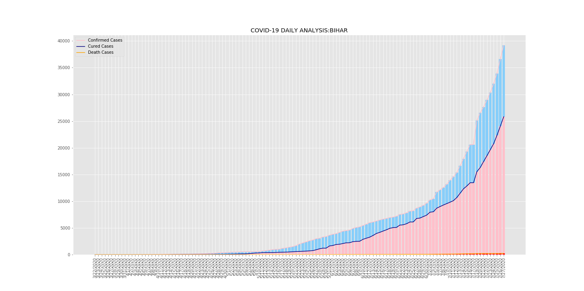
Present state analytics – India
STATE: BIHAR
a. Daily Analysis

Slide 3
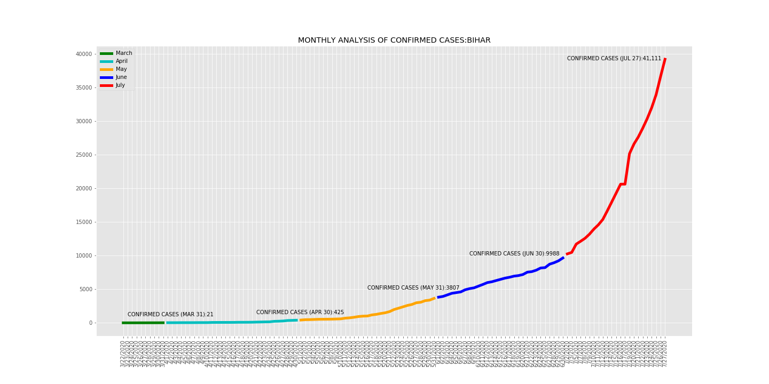
b. Monthly Analysis

Slide 4
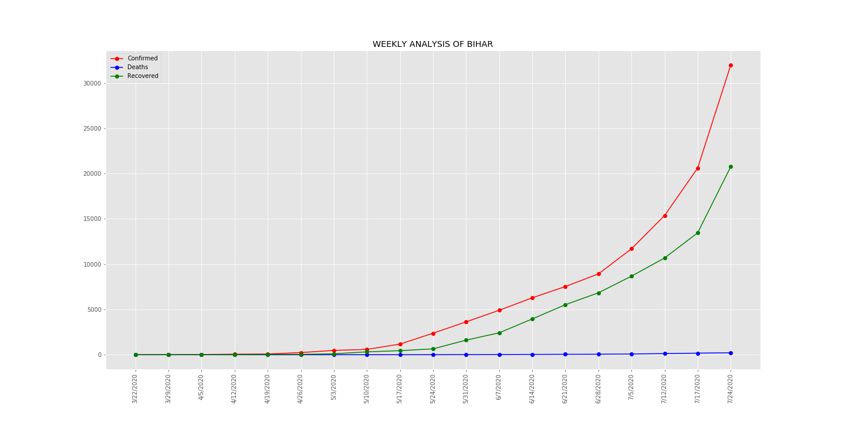
c. Weekly Analysis

Slide 5
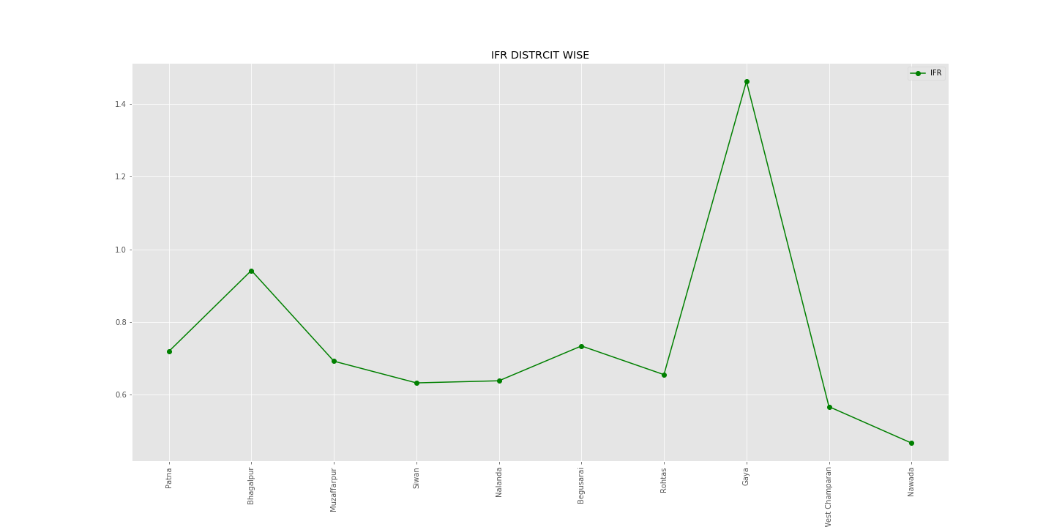
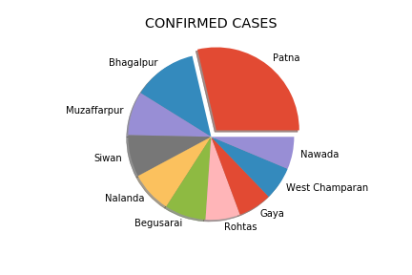
d. District-Wise Analysis

Slide 6
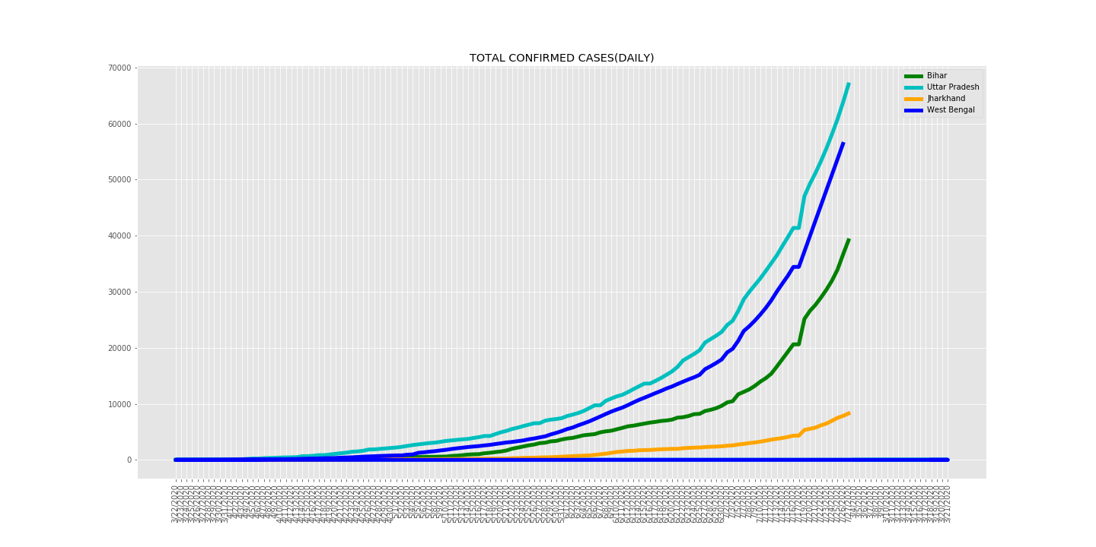
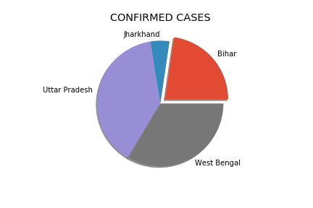
e. Analysis of Bihar with neighboring states

Slide 7
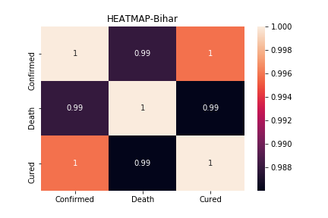
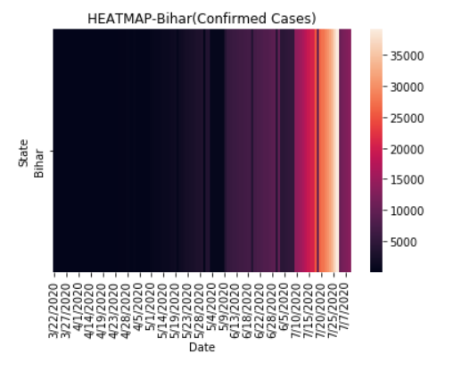
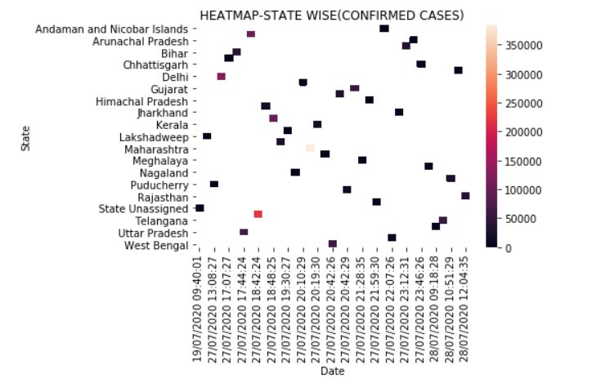
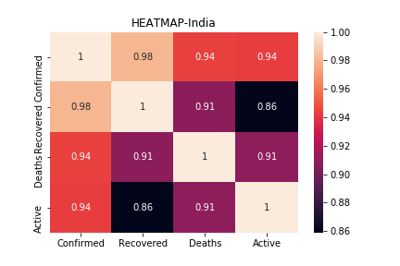
2. Correlation heatmap for various parameters

Slide 8
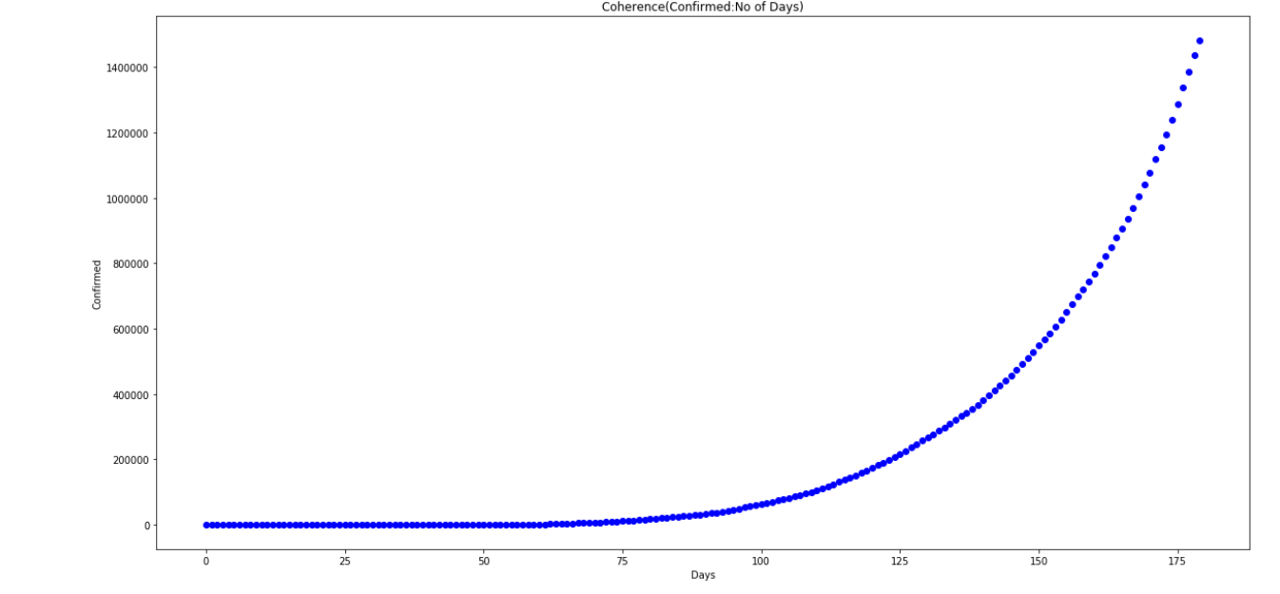
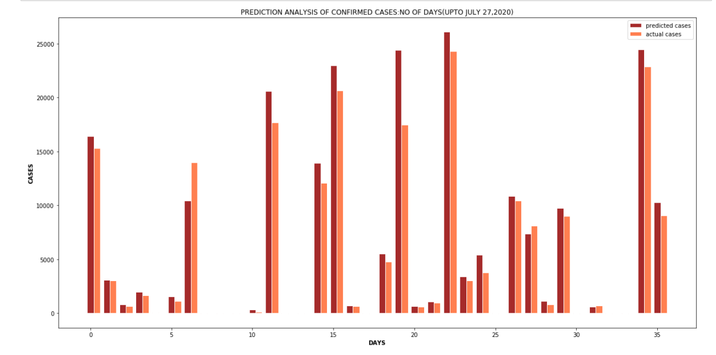
3. Build a model for predicting the confirmed and recovered on any dates past 15th July 2020
Model used: Linear Regression Model

Slide 9
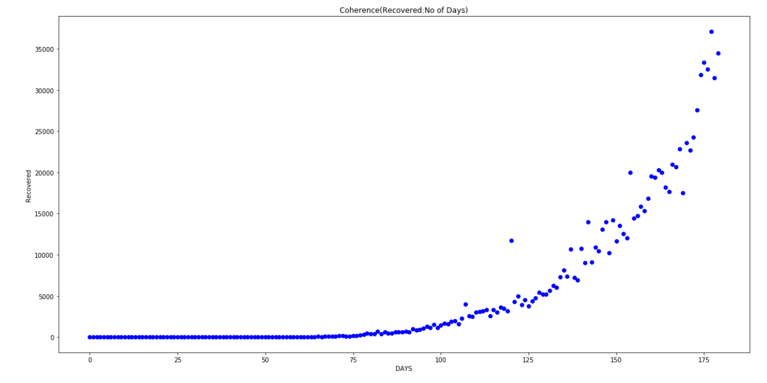
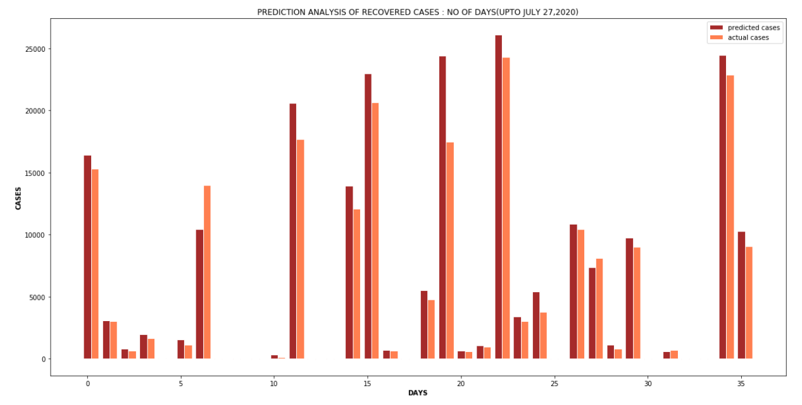
b. Recovered: No of Days

Slide 10
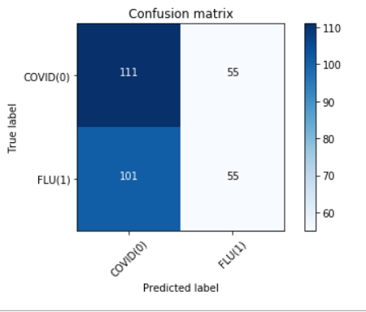
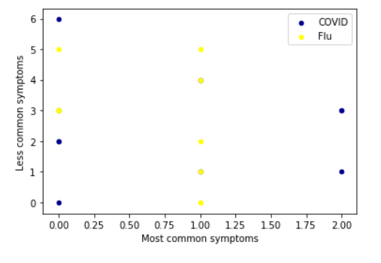
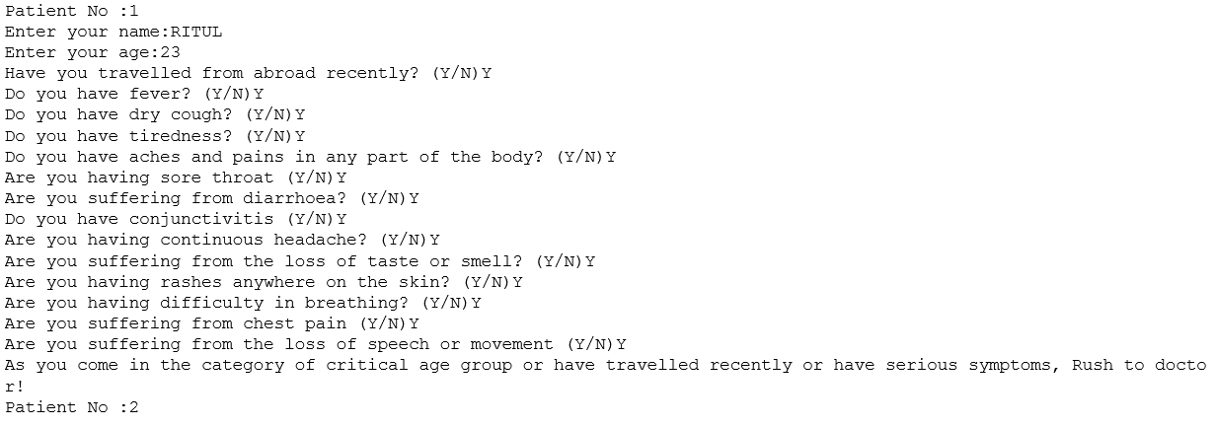
4. Build a classifier for severity gauging (Using SVM Model), Confusion Matrix and COVID Prediction by taking input from user.

